Slide 1
FUNDAMENTAL OF IMAGE PROCESSING
ASSIGNMENT 2
Image Enhancement in Spatial Domain
NAME:
1) LIM BAO JING (A17CS0076)
2) LOW CHIA JING (A17CS0083)
3)TAN SEE JOU (A17CS0218)
LECTURER NAME: DR. MD. SAH BIN HJ. SALAM

Slide 2
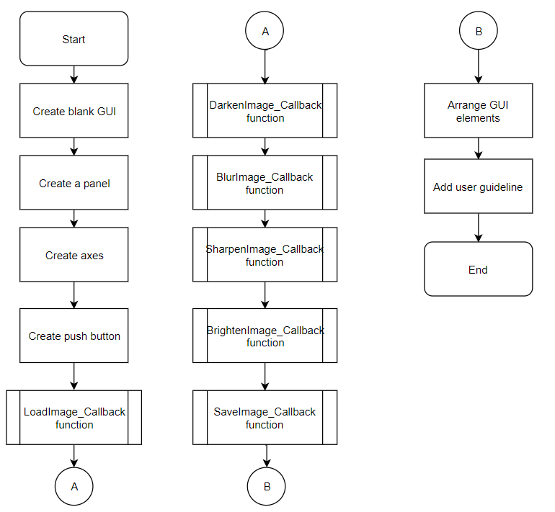
Flow of process

Slide 3
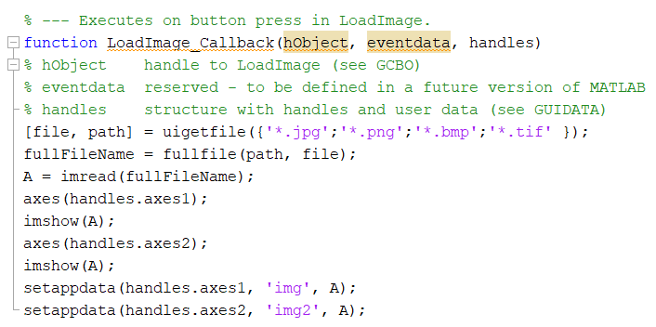
Load Image

Slide 4
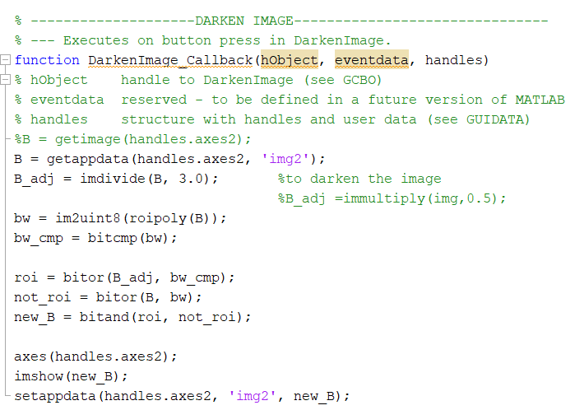
Darken Image

Slide 5
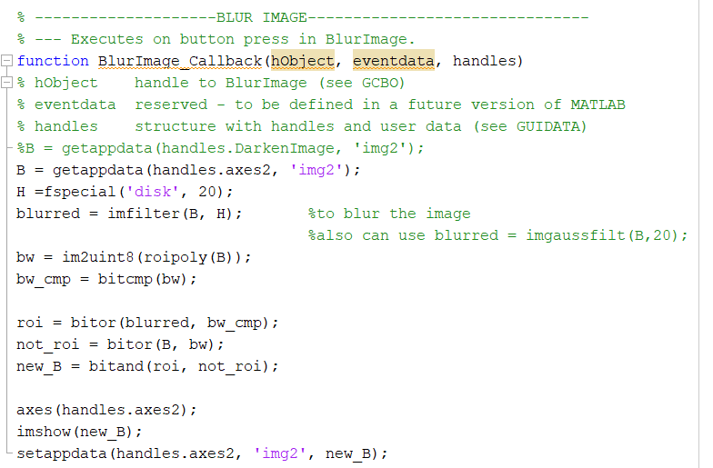
Blur Image

Slide 6
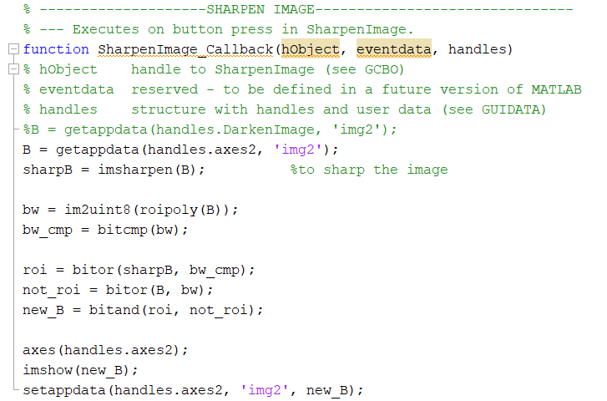
Sharpen Image

Slide 7
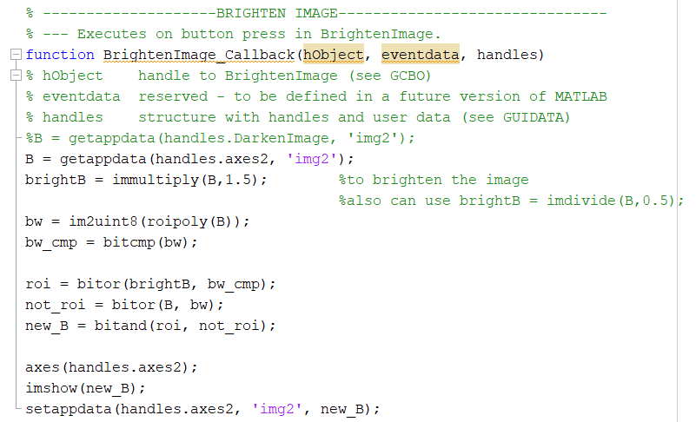
Brighten Image

Slide 8
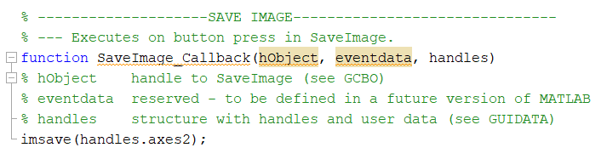
Save Image

Slide 9
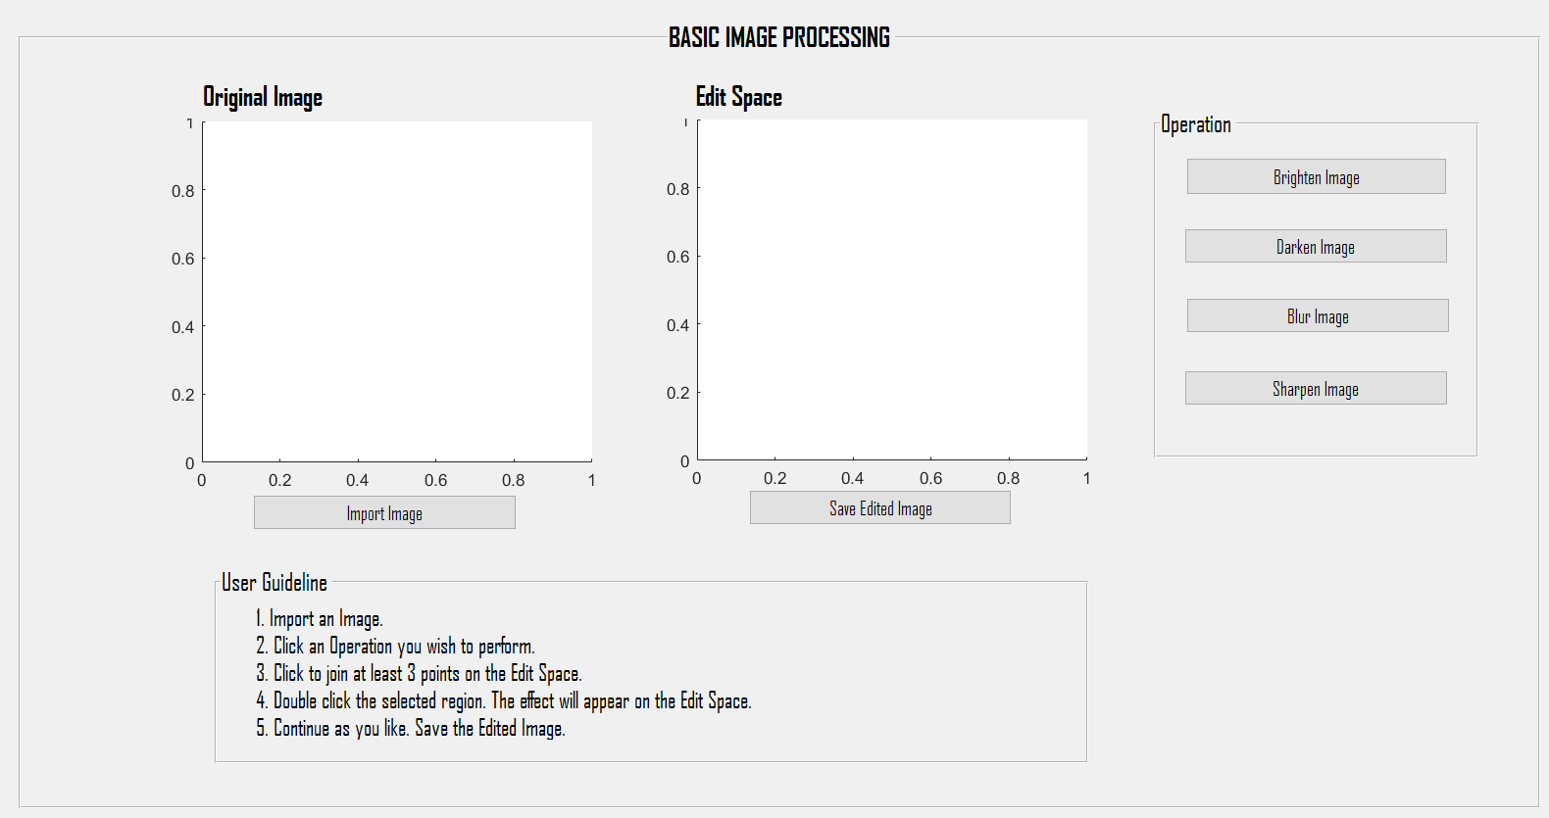
Final GUI

Slide 10
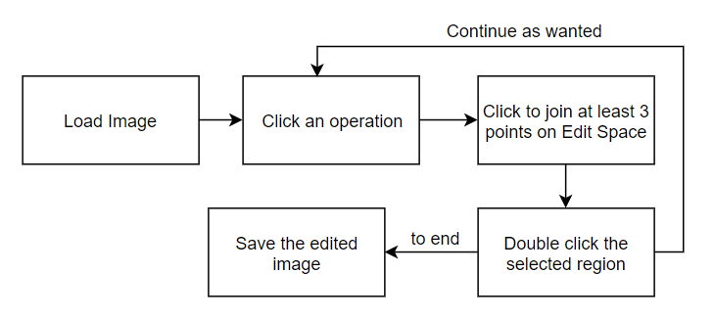
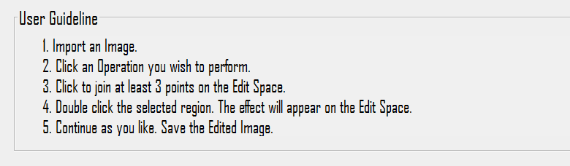
How the user uses the application

Slide 11
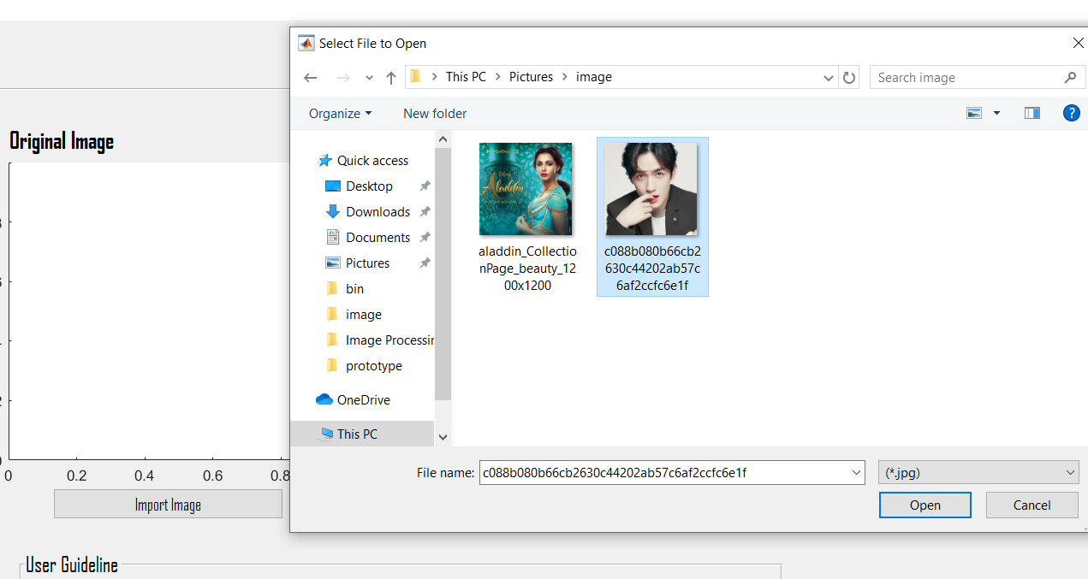
Load Image
The application allows user to load any images from the computer.

Slide 12
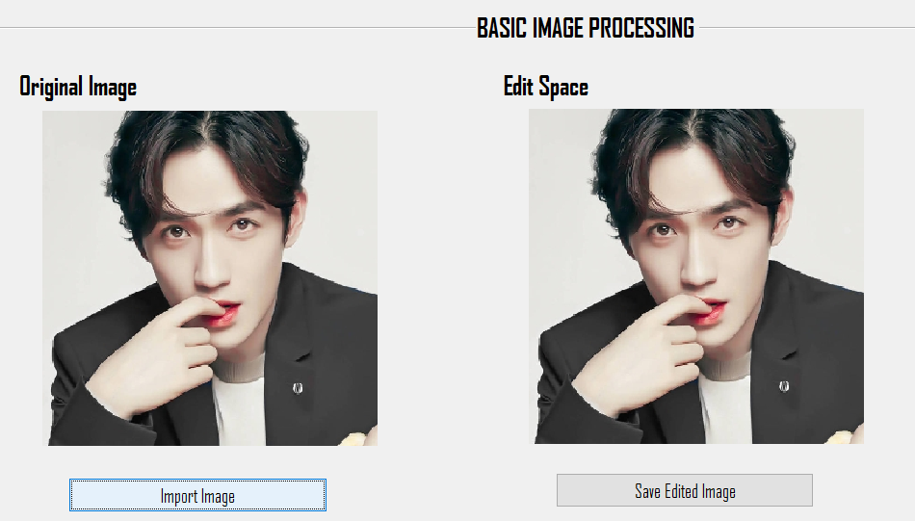
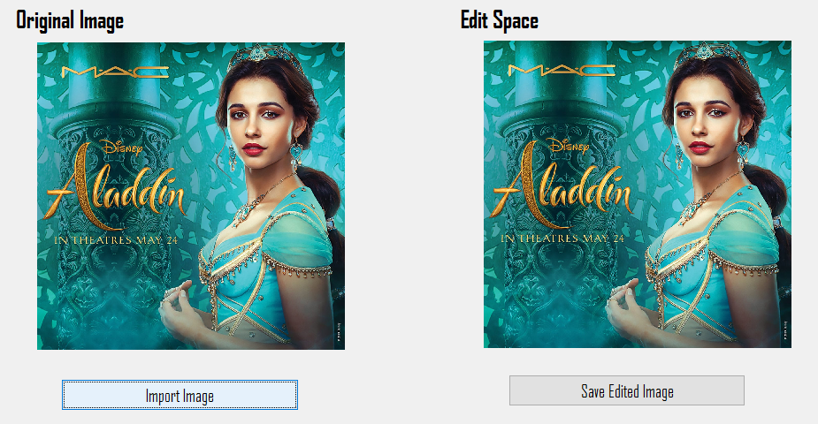
Image loaded in both axes

Slide 13
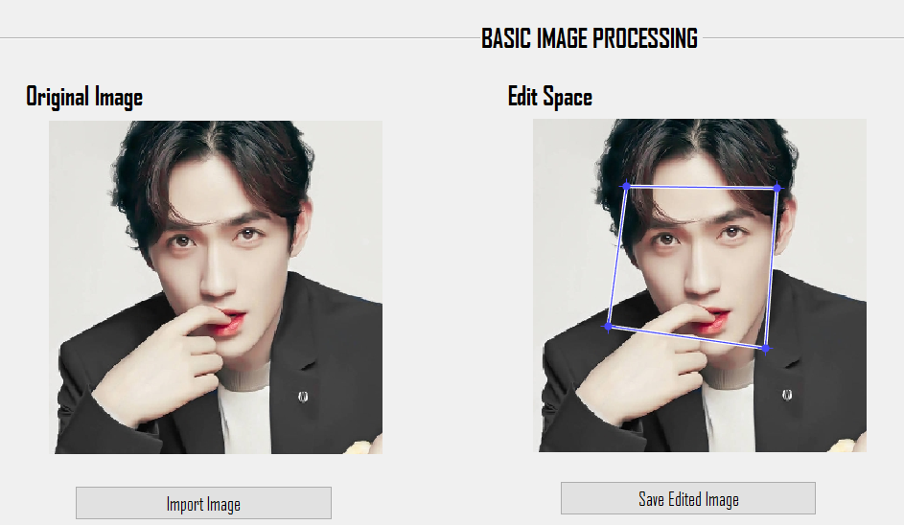
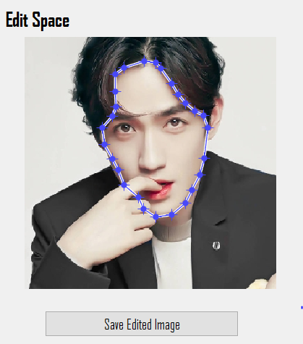
Choose part - in the Edit Space

Slide 14
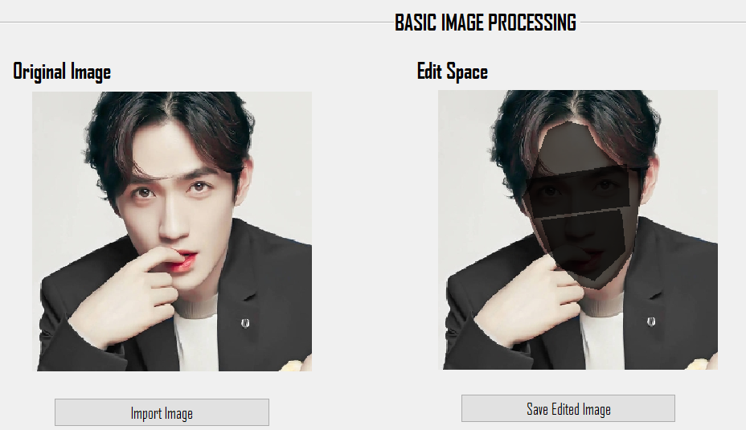
Darken Image
The application allows user to choose parts in the image multiple times.

Slide 15
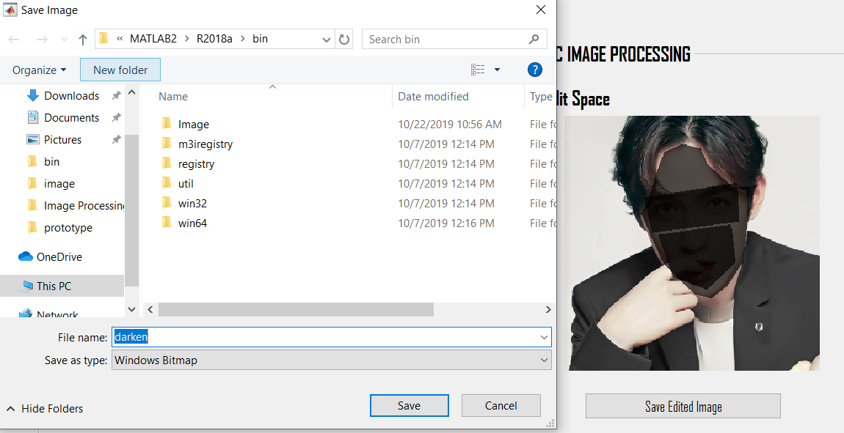
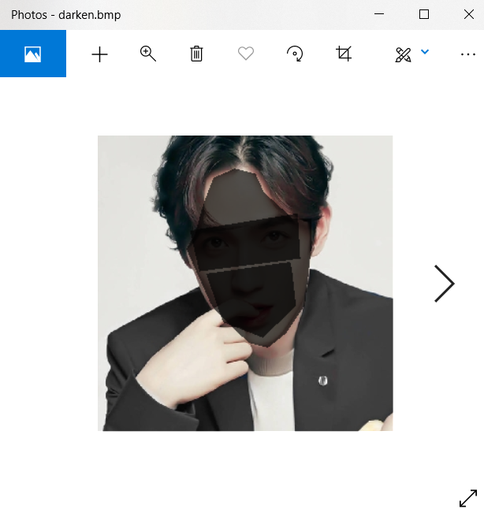
Save Output Image

Slide 16
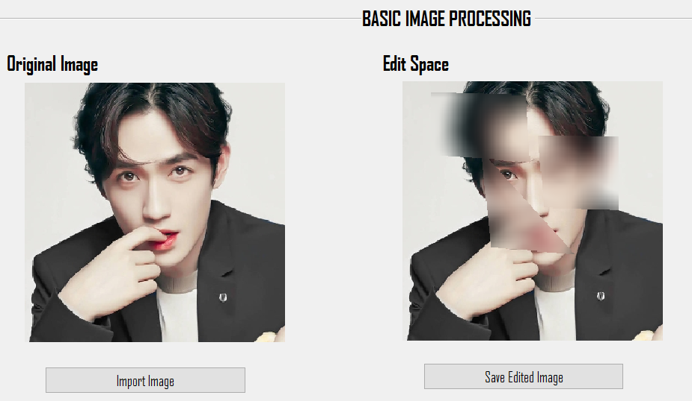
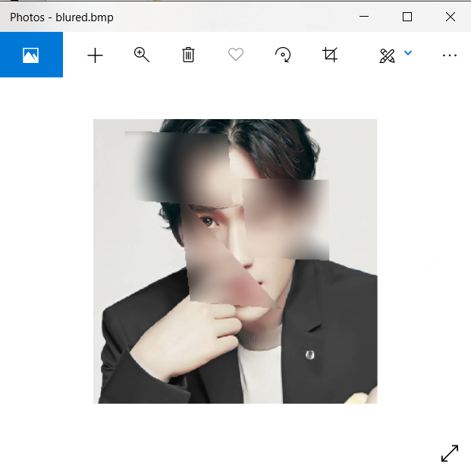
Blur Image

Slide 17
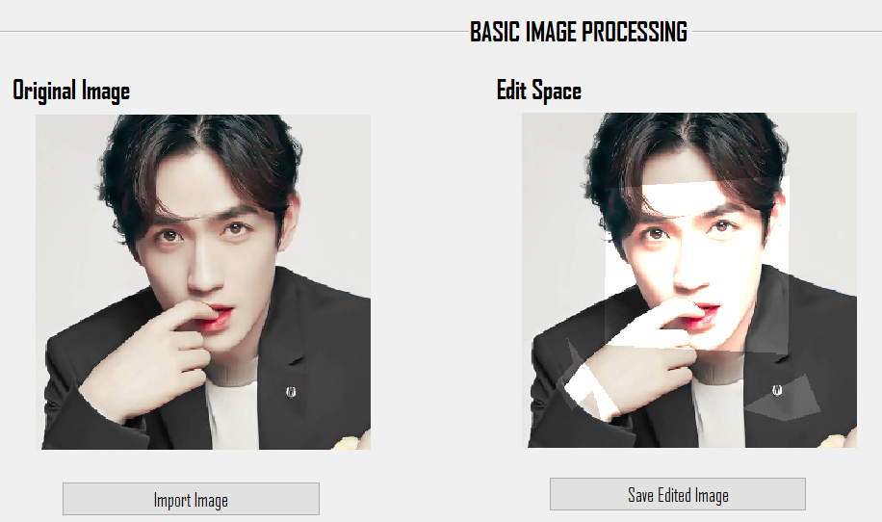
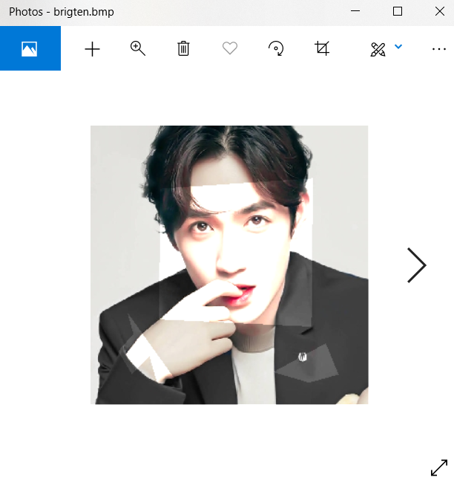
Brighten Image

Slide 18
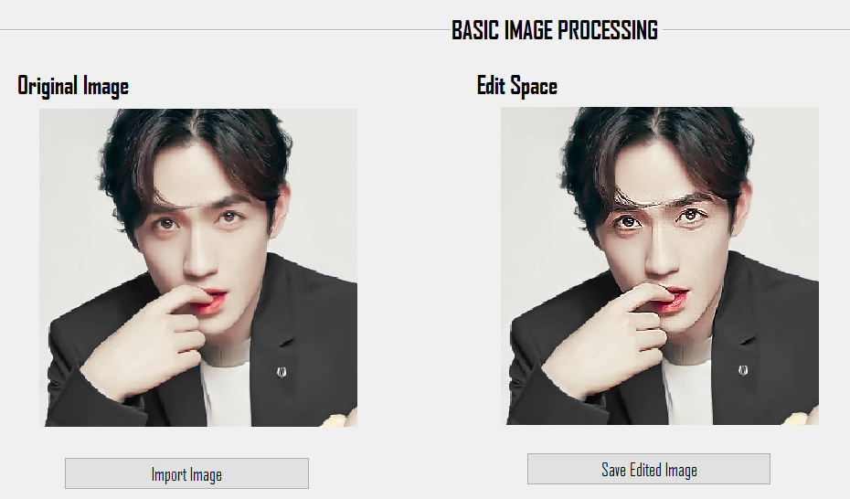
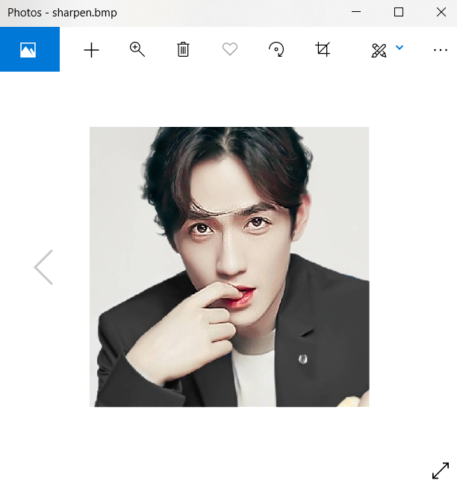
Sharpen Image

Slide 19
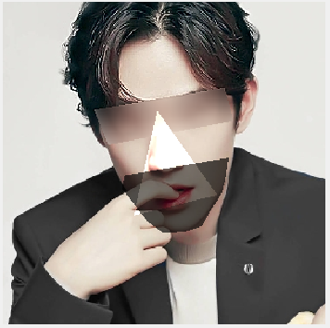

Other sample output

